Slide 1


CLOUD COMPUTING FUNDAMENTALS
From Time-Sharing to AWS and Modern Cloud
60-MINUTE CLASSROOM SESSION • BEGINNER LEVEL
Instructor-Led · Interactive · Beginner Friendly
Cloud Computing Fundamentals
1
Notes:
WHAT TO EXPLAIN: Welcome students. Set expectations: this is an interactive session, hands up for polls, and no prior tech background is needed.
REAL-WORLD ANALOGY: Think of the cloud like electricity from a power plant — you use it without owning the generator.
ASK THE CLASS: Show of hands — who has used Gmail, Instagram, or Netflix today?
COMMON MISCONCEPTION: Students often think 'cloud computing' is a brand-new invention rather than an evolution of older ideas.
APPROX. TIME: 2 minutes

Slide 2




LET'S GET CURIOUS
Where Does Your Data Live?
Gmail
Google Drive
Instagram
Netflix
WhatsApp
Cloud Computing Fundamentals
2
Notes:
WHAT TO EXPLAIN: Every app students use daily stores data somewhere. Today's session explains exactly where and how.
REAL-WORLD ANALOGY: Your data isn't 'in the sky' — it lives on real physical computers in giant warehouses called data centers.
ASK THE CLASS: Where do you think all this data is stored?
COMMON MISCONCEPTION: Many beginners literally believe 'the cloud' means data floats in the sky or the internet itself.
APPROX. TIME: 3 minutes

Slide 3




SETTING THE SCENE
Before the Cloud
Companies had to own, run, and maintain every piece of hardware themselves.
→
→
→
Company
Server Room
Physical Servers
Application
This meant huge upfront cost, long setup times, and constant maintenance — even for a small project.
Cloud Computing Fundamentals
3
Notes:
WHAT TO EXPLAIN: Traditionally, any company that needed computing power had to physically buy, install, and maintain servers on-site.
REAL-WORLD ANALOGY: It's like every restaurant having to build its own power plant just to have electricity.
ASK THE CLASS: Would a small startup want to buy and manage its own server room?
COMMON MISCONCEPTION: Students may not realize software used to require buying physical hardware first.
APPROX. TIME: 3 minutes

Slide 4

HISTORY · 1960S
Time-Sharing: Many Users, One Computer
Computers were huge and expensive, so people shared time on the same machine.
→
User 1
→
→
User 2
Main Computer
User 3
Each user got a small slice of computer time, one after another — so fast it felt instant.
Cloud Computing Fundamentals
4
Notes:
WHAT TO EXPLAIN: In the 1960s, mainframe computers were shared by many people at once, taking turns in tiny time slices — the earliest idea behind 'renting' computing power.
REAL-WORLD ANALOGY: Like sharing one classroom computer where each student gets 2 minutes, then the next student takes over.
ASK THE CLASS: Why do you think sharing one computer was necessary back then?
COMMON MISCONCEPTION: Students may assume each user had their own dedicated computer even in the 1960s.
APPROX. TIME: 3 minutes

Slide 5


HISTORY · 1970S–1990S
Virtualization: One Machine, Many Virtual Machines
→
→
Physical Server
Hypervisor
VM 1
VM 2
VM 3
A hypervisor lets one physical server pretend to be several independent computers.
Each Virtual Machine (VM) has its own OS and apps, but they all share the same physical hardware underneath.
Cloud Computing Fundamentals
5
Notes:
WHAT TO EXPLAIN: Virtualization software (a hypervisor) splits one physical machine into multiple independent virtual machines, massively improving hardware utilization.
REAL-WORLD ANALOGY: Like dividing one large apartment building into separate flats — each tenant has their own space, but they share the same building structure.
ASK THE CLASS: Why would splitting one server into several virtual ones save money?
COMMON MISCONCEPTION: Students may confuse a Virtual Machine with a totally separate physical computer.
APPROX. TIME: 4 minutes

Slide 6

HISTORY · 1990S
The Internet Connects the World
Fast, widespread internet meant computing power no longer had to be next to the user.
→
→
User's Computer
The Internet
Remote Server
For the first time, people could access computing resources far away — this is the missing piece that made real cloud computing possible.
Cloud Computing Fundamentals
6
Notes:
WHAT TO EXPLAIN: The growth of the internet in the 1990s allowed users to reach powerful remote computers instantly — without it, 'renting' computing over a network wouldn't be possible.
REAL-WORLD ANALOGY: Like a delivery road system being built before online shopping could ever work.
ASK THE CLASS: Why couldn't cloud computing exist without a fast, reliable internet?
COMMON MISCONCEPTION: Some think cloud computing began the moment the internet existed — really, more pieces were still needed.
APPROX. TIME: 3 minutes

Slide 7


HISTORY · 2000S
The 2000s: Modern Cloud Emerges
Traditional IT
Cloud Computing
Buy physical servers
Request resources online
Install operating systems
Configure in minutes
Configure networking manually
Networking is automated
Maintain hardware forever
Provider maintains hardware
Wait weeks to scale up
Scale up or down instantly
Cloud Computing Fundamentals
7
Notes:
WHAT TO EXPLAIN: By the 2000s, companies began offering computing resources as an on-demand service instead of something you had to buy and manage yourself.
REAL-WORLD ANALOGY: Like the shift from owning a car to using a ride-hailing app — the outcome (going somewhere) is the same, but you no longer own or maintain the vehicle.
ASK THE CLASS: Which approach sounds faster to get started with: buying or requesting?
COMMON MISCONCEPTION: Students might think 'cloud' just means 'the internet' rather than an on-demand delivery model.
APPROX. TIME: 3 minutes

Slide 8

HISTORY · 2006
AWS: A Major Milestone
Amazon Web Services launched core infrastructure services, making cloud computing practical and affordable for everyone.
EC2
S3
Rent virtual servers by the hour
Store unlimited files in the cloud
Important: AWS did NOT invent cloud computing by itself. It built on decades of time-sharing, virtualization, and internet growth — then made it easy to buy.
Cloud Computing Fundamentals
8
Notes:
WHAT TO EXPLAIN: AWS launched S3 (storage) in March 2006 and EC2 (compute) in August 2006, offering infrastructure as a pay-as-you-go service for the first time at scale.
REAL-WORLD ANALOGY: AWS is like the first company to open a 24/7 rental store for computers — the idea of renting existed before, but AWS made it simple and available to anyone with a credit card.
ASK THE CLASS: Why was it a big deal that anyone — even a student — could rent a server for a few cents an hour?
COMMON MISCONCEPTION: A very common myth: 'AWS invented the cloud.' Clarify it was a major milestone, not the origin.
APPROX. TIME: 4 minutes

Slide 9



HISTORY RECAP
Cloud Computing Evolution: A 60-Year Journey
1960s
1970s–90s
1990s
2000s
2006
Today
Time-
Sharing
Virtual-
ization
Internet
Growth
Modern
Cloud
AWS
Services
Cloud +
AI
Cloud computing was not invented in one moment — it evolved gradually from many technologies over 60 years.
Cloud Computing Fundamentals
9
Notes:
WHAT TO EXPLAIN: Walk left to right across the timeline, reinforcing each milestone briefly before moving to definitions.
REAL-WORLD ANALOGY: Like a river formed by many small streams joining together over time, not from a single source.
ASK THE CLASS: Which milestone do you think mattered the most, and why?
COMMON MISCONCEPTION: That cloud computing is a single invention rather than a gradual evolution.
APPROX. TIME: 3 minutes

Slide 10

ASK THE CLASS
Was Cloud Computing Created by AWS?
Yes, AWS invented it
A
No, it already existed before AWS
B
Partially — AWS built on decades of earlier tech
✓ CORRECT
C
Reveal: Option C is correct — AWS was a milestone, not the origin.
Cloud Computing Fundamentals
10
Notes:
WHAT TO EXPLAIN: Let students vote by show of hands for A, B, or C before revealing. Reinforce that cloud computing evolved from time-sharing and virtualization long before AWS.
REAL-WORLD ANALOGY: AWS is like the first company to build a highway system for computing — the cars (data and applications) already existed, but AWS made travel much easier.
ASK THE CLASS: Was Cloud Computing created by AWS?
COMMON MISCONCEPTION: This is the single most common beginner misconception about cloud history.
APPROX. TIME: 3 minutes

Slide 11
CORE CONCEPT
What Is Cloud Computing?
“Cloud Computing is the delivery of computing resources over the Internet, on demand.”
→
→
→
Compute
Storage
Database
Network
You
Internet
The Cloud
Cloud Computing Fundamentals
11
Notes:
WHAT TO EXPLAIN: Cloud computing means using computing power (servers, storage, databases, networking) that lives elsewhere and is accessed over the internet, paid for as you use it.
REAL-WORLD ANALOGY: Like using electricity from the grid instead of running your own power generator — you just plug in and pay for what you use.
ASK THE CLASS: Does 'cloud computing' mean your data is literally stored in the sky?
COMMON MISCONCEPTION: The word 'cloud' makes many beginners think data is stored somewhere abstract or non-physical.
APPROX. TIME: 4 minutes

Slide 12




BEHIND THE SCENES
What Is Inside “The Cloud”?
Data Centers
Servers
Storage
Networking
Power
Cooling
Security
Cloud Computing Fundamentals
12
Notes:
WHAT TO EXPLAIN: The cloud is not magic — it's real physical infrastructure: rooms full of servers, storage drives, networking equipment, backup power, cooling systems, and layers of security.
REAL-WORLD ANALOGY: Like a giant factory that runs 24/7 to keep websites and apps working, with power backups and security guards.
ASK THE CLASS: Which of these seven parts do you think a cloud provider spends the most money on?
COMMON MISCONCEPTION: Believing the cloud has no physical form at all.
APPROX. TIME: 3 minutes

Slide 13
VISUALIZE IT
Inside a Cloud Data Center
Network Equipment — connects everything together
Cooling Systems — prevent overheating
Backup Power — keeps servers running 24/7
Security — physical & digital protection
SERVER RACKS
Cloud Computing Fundamentals
13
Notes:
WHAT TO EXPLAIN: A data center is a purpose-built facility packed with racks of servers, plus networking, cooling, power backup, and security to keep everything running non-stop.
REAL-WORLD ANALOGY: Like a massive library, except instead of books on shelves, it's servers in racks, each one storing and processing data.
ASK THE CLASS: Why do you think cooling is just as important as the servers themselves?
COMMON MISCONCEPTION: Assuming a data center is just 'a room with computers' rather than a highly engineered facility.
APPROX. TIME: 3 minutes

Slide 14
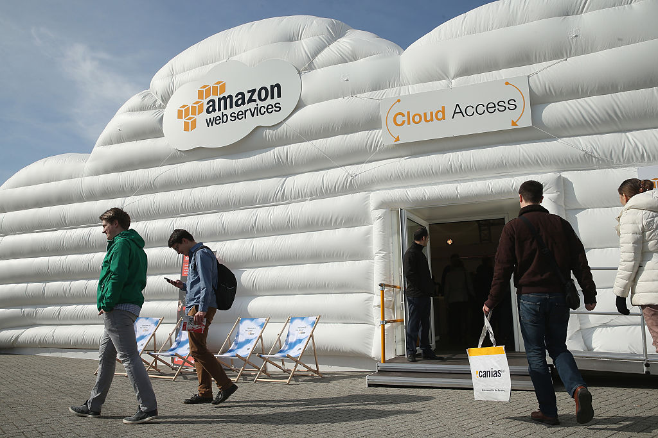
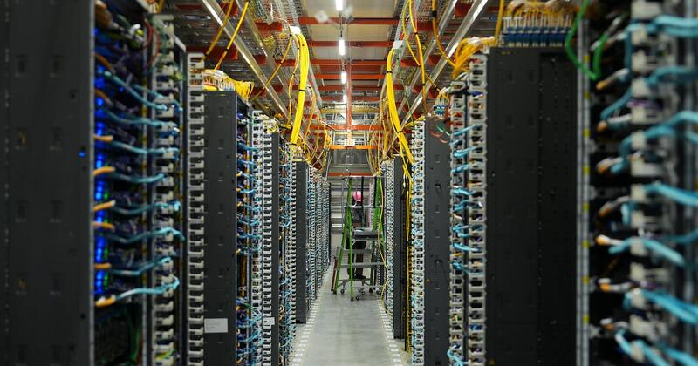
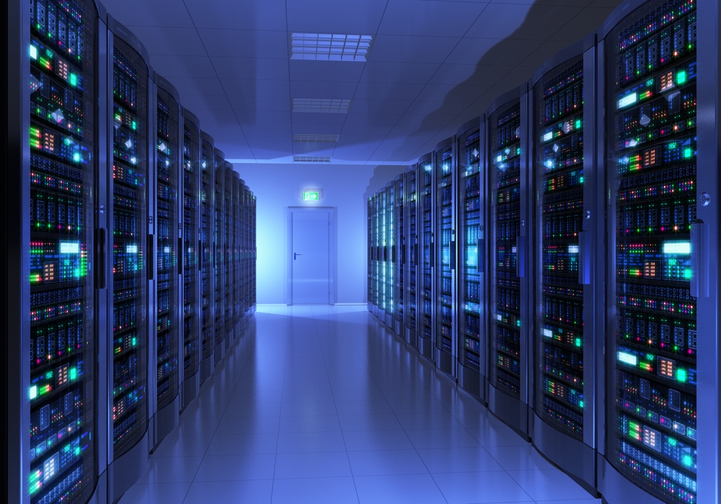

Slide 15


CORE CONCEPT
Why Do We Need Cloud Computing?
Scalability
Cost Efficiency
Availability
Global Access
Fast Deployment
Grow resources as you grow
Pay only for what you use
Stay online, even during failures
Reach users anywhere on Earth
Launch in minutes, not months
Cloud Computing Fundamentals
14
Notes:
WHAT TO EXPLAIN: These five benefits explain why organizations of every size moved to the cloud: elastic scale, pay-as-you-go cost, high availability, worldwide reach, and speed of launching new services.
REAL-WORLD ANALOGY: Like renting a moving van only on the weekend you actually move, instead of buying a truck you use once a year.
ASK THE CLASS: Which of these five benefits do you think matters most to a small startup?
COMMON MISCONCEPTION: Thinking cloud computing is always cheaper in every situation — it depends on usage patterns.
APPROX. TIME: 4 minutes

Slide 16

REAL-WORLD SCENARIO
The Festival Sale Traffic Spike
An online shopping website normally has 1,000 users — but gets 100,000 users during a festival sale.
ASK: What problem might happen? (Think for 15 seconds)
High CPU usage
Increased traffic
More resource demand
Possible slowdowns / crashes
Cloud Computing Fundamentals
15
Notes:
WHAT TO EXPLAIN: A sudden 100x jump in users can overwhelm fixed infrastructure. Cloud computing solves this by adding resources automatically when demand spikes, then removing them afterward.
REAL-WORLD ANALOGY: Like a restaurant that can instantly add 20 extra tables and staff only on its busiest night, then scale back down the next day.
ASK THE CLASS: What problem might happen when traffic jumps from 1,000 to 100,000 users?
COMMON MISCONCEPTION: Assuming a website automatically handles any amount of traffic without extra resources.
APPROX. TIME: 4 minutes

Slide 17

CORE CONCEPT
Scalability vs. Elasticity
Normal Traffic
Festival Sale (High Traffic)
After Sale (Low Traffic)
→
→
2 Servers
10 Servers
2 Servers
Scalability = the ability to handle growth (add more resources permanently as you grow).
Elasticity = the ability to automatically add or remove resources based on demand, in real time.
Cloud Computing Fundamentals
16
Notes:
WHAT TO EXPLAIN: Scalability is about designing systems that CAN grow; elasticity is the automatic, on-demand stretching and shrinking of resources to match real-time traffic.
REAL-WORLD ANALOGY: Scalability is like a stretchy waistband designed to fit different sizes. Elasticity is like that waistband automatically tightening and loosening as you breathe in and out.
ASK THE CLASS: After the festival sale ends, what should happen to the extra 8 servers?
COMMON MISCONCEPTION: Treating 'scalability' and 'elasticity' as identical terms — they are related but distinct.
APPROX. TIME: 4 minutes

Slide 18
VOTE NOW
How Would You Handle a Traffic Spike?
Buy a new physical server immediately
A
Increase cloud resources
✓ BEST CHOICE
B
Shut down the application
C
Raise your hand for A, B, or C — then we reveal the best answer together.
Cloud Computing Fundamentals
17
Notes:
WHAT TO EXPLAIN: Buying new hardware takes too long, and shutting down loses customers. Cloud resources can be added within minutes — this is elasticity in action.
REAL-WORLD ANALOGY: Like calling in extra delivery drivers for one busy night instead of buying a new delivery van you'll rarely use.
ASK THE CLASS: How would you handle a sudden traffic spike?
COMMON MISCONCEPTION: Assuming buying more hardware is always the fastest fix.
APPROX. TIME: 3 minutes

Slide 19


CORE CONCEPT
Cloud Service Models: IaaS, PaaS, SaaS
As you move from IaaS to SaaS, the provider manages more — and you manage less.
SaaS
Software as a Service
PaaS
Platform as a Service
IaaS
Infrastructure as a Service
You Manage More → ← Provider Manages More
Cloud Computing Fundamentals
18
Notes:
WHAT TO EXPLAIN: IaaS gives you raw infrastructure, PaaS gives you a ready platform for building apps, and SaaS gives you fully finished software to use directly.
REAL-WORLD ANALOGY: IaaS is renting an empty plot of land, PaaS is renting a fully built kitchen, and SaaS is ordering a finished meal.
ASK THE CLASS: Which of these three would need the LEAST technical setup from the customer?
COMMON MISCONCEPTION: Mixing up the responsibility split between the provider and the customer across the three models.
APPROX. TIME: 3 minutes

Slide 20

SERVICE MODEL 1 OF 3
IaaS — Infrastructure as a Service
Analogy: Renting a Computer
Virtual Machine
CPU
RAM
Storage
Networking
Customer Manages
Provider Manages
Operating System
Applications & data
Runtime & middleware
Physical servers
Storage hardware
Networking & data centers
Cloud Computing Fundamentals
19
Notes:
WHAT TO EXPLAIN: With IaaS, the provider gives you raw virtual infrastructure (servers, storage, networking) but you install and manage the operating system and everything above it.
REAL-WORLD ANALOGY: Like renting an empty apartment with plumbing and electricity already connected — you still bring and arrange your own furniture.
ASK THE CLASS: If you rent a virtual machine, who is responsible for installing the operating system?
COMMON MISCONCEPTION: Assuming the cloud provider manages your operating system and applications too in IaaS.
APPROX. TIME: 4 minutes

Slide 21

SERVICE MODEL 2 OF 3
PaaS — Platform as a Service
Analogy: Renting a Ready-to-Use Kitchen
Everything is already set up — the OS, servers, and runtime — so developers can focus purely on writing and running code.
PaaS Handles:
Operating system
Servers & storage
Runtime environment
Scaling infrastructure
→
You: Write & Deploy Code
Cloud Computing Fundamentals
20
Notes:
WHAT TO EXPLAIN: PaaS removes the need to manage servers or operating systems at all — developers simply push their application code and the platform runs it.
REAL-WORLD ANALOGY: Like renting a fully equipped kitchen — you just bring your recipe (code) and start cooking; the stove, oven, and utensils are already there.
ASK THE CLASS: Would a developer using PaaS need to install an operating system?
COMMON MISCONCEPTION: Confusing PaaS with simply 'a website builder' — PaaS is a platform for running custom application code.
APPROX. TIME: 3 minutes

Slide 22



SERVICE MODEL 3 OF 3
SaaS — Software as a Service
Fully finished software, ready to use instantly through a browser — no installation, no setup.
Gmail
Google Docs
Microsoft 365
Salesforce
→
→
User
Internet
Software (SaaS)
Cloud Computing Fundamentals
21
Notes:
WHAT TO EXPLAIN: SaaS is the model most students already use daily. The provider manages absolutely everything — you just log in and use the app.
REAL-WORLD ANALOGY: Like ordering a finished meal at a restaurant — you don't cook, clean, or manage the kitchen at all.
ASK THE CLASS: Which cloud service model requires the LEAST work from the customer?
COMMON MISCONCEPTION: Not realizing that everyday apps like Gmail are themselves examples of cloud computing (SaaS).
APPROX. TIME: 3 minutes

Slide 23
CLASSIFY IT
Can You Identify IaaS, PaaS, or SaaS?
1.
Renting a virtual server and installing your own OS
IaaS
2.
Using a platform to deploy your app without managing servers
PaaS
3.
Logging into Gmail to check your email
SaaS
Cloud Computing Fundamentals
22
Notes:
WHAT TO EXPLAIN: Read each scenario aloud, pause for student answers, then reveal the pill showing the correct classification.
REAL-WORLD ANALOGY: Recall: IaaS = empty plot of land, PaaS = ready kitchen, SaaS = finished meal.
ASK THE CLASS: Which model does each scenario describe?
COMMON MISCONCEPTION: Confusing 'using an app' (SaaS) with 'building an app on a platform' (PaaS).
APPROX. TIME: 4 minutes

Slide 24


CORE CONCEPT
Cloud Deployment Models
Not just HOW you use the cloud — but WHERE that cloud infrastructure lives and who it serves.
Public Cloud
Private Cloud
Hybrid Cloud
Shared infrastructure, open to any customer
Dedicated infrastructure for one organization
A mix of public and private, connected together
Cloud Computing Fundamentals
23
Notes:
WHAT TO EXPLAIN: Deployment models describe where cloud infrastructure is hosted and who has access to it — a separate concept from service models (IaaS/PaaS/SaaS).
REAL-WORLD ANALOGY: Public cloud is like a shared co-working space; private cloud is like your own private office; hybrid is using both depending on the need.
ASK THE CLASS: Why might a bank prefer more control over its infrastructure than a small blog would need?
COMMON MISCONCEPTION: Mixing up deployment models (public/private/hybrid) with service models (IaaS/PaaS/SaaS) — they answer different questions.
APPROX. TIME: 3 minutes

Slide 25
DEPLOYMENT MODEL 1 OF 3
Public Cloud
Shared Infrastructure
Benefits
Low cost — pay-as-you-go
No hardware to maintain
Scales instantly
Great for startups & general apps
Org A
Org B
Org C
↓
↓
↓
Shared Cloud Provider Infrastructure (logically isolated per customer)
Typical use case: Websites, mobile apps, dev/test environments
Cloud Computing Fundamentals
24
Notes:
WHAT TO EXPLAIN: Public cloud infrastructure is owned by the provider (like AWS) and shared among many customers, though each customer's data is kept logically separate and secure.
REAL-WORLD ANALOGY: Like an apartment building — many tenants share the building, but each has their own locked, private unit.
ASK THE CLASS: Why is public cloud usually the cheapest option to get started with?
COMMON MISCONCEPTION: Thinking 'shared infrastructure' means other companies can see your data — isolation keeps it separate and secure.
APPROX. TIME: 3 minutes

Slide 26

DEPLOYMENT MODEL 2 OF 3
Private Cloud
Dedicated Infrastructure
Benefits
Full control over infrastructure
Higher security & compliance
Customizable to strict requirements
Higher cost than public cloud
One Organization (e.g. a Bank)
↓
Dedicated Infrastructure — used by ONLY this organization
Typical use case: Banks, hospitals, government agencies
Cloud Computing Fundamentals
25
Notes:
WHAT TO EXPLAIN: A private cloud is built and used exclusively by one organization, offering more control and security but at a higher cost than shared public cloud infrastructure.
REAL-WORLD ANALOGY: Like owning your own private house instead of renting an apartment — more control, but more responsibility and cost.
ASK THE CLASS: Why might a hospital choose private cloud over public cloud for patient records?
COMMON MISCONCEPTION: Assuming private cloud always means 'on-premises' — it can also be hosted by a provider but dedicated to one customer.
APPROX. TIME: 3 minutes

Slide 27
DEPLOYMENT MODEL 3 OF 3
Hybrid Cloud
Organizations combine private and public cloud, connected securely, to get the best of both.
→
Secure
Connection
→
Company Data Center
Public Cloud
Private / on-premises
Scalable & flexible
Why combine? Keep sensitive data private on-premises, while using public cloud for scalable, less-sensitive workloads like websites or testing.
Cloud Computing Fundamentals
26
Notes:
WHAT TO EXPLAIN: Hybrid cloud connects private infrastructure and public cloud so organizations can choose the best environment for each workload.
REAL-WORLD ANALOGY: Like keeping valuables in a home safe (private) but using a public storage unit (public cloud) for seasonal items.
ASK THE CLASS: Why might a company keep customer data on-premises but run its website on public cloud?
COMMON MISCONCEPTION: Assuming hybrid cloud means everything is duplicated everywhere, rather than intentionally split by workload.
APPROX. TIME: 3 minutes

Slide 28

THE MARKET
Major Cloud Providers
AWS
Microsoft Azure
Google Cloud
Amazon Web Services — market leader
Strong in enterprise & hybrid
Strong in data & AI
Oracle Cloud
IBM Cloud
Cloud Computing Fundamentals
27
Notes:
WHAT TO EXPLAIN: AWS, Microsoft Azure, and Google Cloud are the 'big three' cloud providers, with Oracle Cloud and IBM Cloud serving more specialized markets.
REAL-WORLD ANALOGY: Like the major airlines of the cloud world — different providers, similar destination (getting your workload running).
ASK THE CLASS: Have you heard of any of these providers before today?
COMMON MISCONCEPTION: Thinking AWS is the only cloud provider that exists.
APPROX. TIME: 2 minutes

Slide 29

GOING GLOBAL
AWS Global Infrastructure
Region
A geographic area (e.g. Mumbai, Frankfurt, Virginia) containing multiple data centers
Availability Zone
One or more isolated data centers within a Region, each with independent power & networking
Data Center
The physical building full of servers, storage, and networking hardware
Cloud Computing Fundamentals
28
Notes:
WHAT TO EXPLAIN: AWS organizes its global infrastructure into Regions (large geographic areas), which contain multiple Availability Zones, which each contain one or more physical Data Centers.
REAL-WORLD ANALOGY: A Region is like a country, an Availability Zone is like a city within it, and a Data Center is like one specific building in that city.
ASK THE CLASS: Why would AWS build multiple isolated Availability Zones instead of just one giant data center?
COMMON MISCONCEPTION: Assuming a 'Region' is a single building rather than a broad geographic cluster of multiple independent facilities.
APPROX. TIME: 3 minutes

Slide 30



AWS BASICS
Introduction to AWS Services
EC2
S3
VPC
Compute
Storage
Networking
RDS
IAM
CloudWatch
Database
Identity & Access
Monitoring
Cloud Computing Fundamentals
29
Notes:
WHAT TO EXPLAIN: This map previews the core AWS services we'll explore next: EC2 for compute, S3 for storage, VPC for networking, plus RDS, IAM, and CloudWatch supporting the full picture.
REAL-WORLD ANALOGY: Like a toolbox — each AWS service is a specific tool for a specific job.
ASK THE CLASS: Based on the names, which service do you think handles security and permissions?
COMMON MISCONCEPTION: Assuming all AWS services do the same thing, rather than each serving a distinct purpose.
APPROX. TIME: 2 minutes

Slide 31
AWS SERVICE · COMPUTE
EC2 — Your Virtual Server
→
→
→
→
User
Internet
AWS
EC2
Application
EC2 is a virtual server you can turn on, configure, and use in minutes.
CPU / vCPU — processing power
RAM — temporary working memory
Operating System — Windows or Linux
Storage — attached disk space
Cloud Computing Fundamentals
30
Notes:
WHAT TO EXPLAIN: EC2 (Elastic Compute Cloud) lets you rent a virtual server with the CPU, RAM, OS, and storage you choose, and pay only while it's running.
REAL-WORLD ANALOGY: Like renting a fully equipped computer that lives in AWS's data center instead of on your desk.
ASK THE CLASS: If your website suddenly gets more visitors, could you switch to a bigger EC2 server easily?
COMMON MISCONCEPTION: Confusing EC2 (a virtual server) with S3 (storage for files) — they serve very different purposes.
APPROX. TIME: 3 minutes

Slide 32



AWS SERVICE · STORAGE
S3 — Object Storage
Images
→
→
→
Videos
User
Internet
S3 Bucket
Documents
S3 (Simple Storage Service) stores files as “objects” in containers called buckets — built for durability, unlimited scale, and easy access from anywhere.
Cloud Computing Fundamentals
31
Notes:
WHAT TO EXPLAIN: S3 stores files (objects) such as images, videos, and documents in organized containers called buckets, and can scale to virtually unlimited storage.
REAL-WORLD ANALOGY: Like an enormous, endlessly expandable digital filing cabinet accessible from anywhere in the world.
ASK THE CLASS: Which service would you choose to store millions of user-uploaded photos: EC2 or S3?
COMMON MISCONCEPTION: Thinking S3 is a virtual computer like EC2, rather than a storage-only service.
APPROX. TIME: 3 minutes

Slide 33

AWS SERVICE · NETWORKING
VPC — Your Private Network in AWS
VPC (Virtual Private Cloud)
Subnet
→
→
EC2 Instance
Internet Gateway
Security Controls
A VPC is an isolated section of the AWS cloud where you control your own network — who can connect, and how.
Cloud Computing Fundamentals
32
Notes:
WHAT TO EXPLAIN: A VPC lets you create your own logically isolated network inside AWS, defining subnets, gateways, and security rules — keep this beginner-friendly, avoid deep networking detail.
REAL-WORLD ANALOGY: Like having your own private, gated community inside a large city (AWS) — you decide who can enter and how.
ASK THE CLASS: Why might a company want to control exactly who can access their EC2 servers?
COMMON MISCONCEPTION: Assuming all AWS resources are open to the public internet by default.
APPROX. TIME: 3 minutes

Slide 34
CHOOSE THE SERVICE
Choose the Right AWS Service
1.
Run a web application
EC2
2.
Store images and files
S3
3.
Create a virtual network
VPC
Cloud Computing Fundamentals
33
Notes:
WHAT TO EXPLAIN: Reinforce the three AWS services covered: EC2 for compute, S3 for storage, VPC for networking.
REAL-WORLD ANALOGY: Match each scenario to the right 'tool in the toolbox.'
ASK THE CLASS: Which AWS service fits each scenario?
COMMON MISCONCEPTION: Mixing up which service handles compute vs. storage vs. networking.
APPROX. TIME: 3 minutes

Slide 35


IT'S EVERYWHERE
Cloud Computing in Real Life
Netflix
Google
Instagram
Online Banking
E-commerce
Gaming
Education
Cloud Computing Fundamentals
34
Notes:
WHAT TO EXPLAIN: Nearly every modern digital service students use daily — streaming, social media, banking, shopping, gaming, and online learning — runs on cloud infrastructure.
REAL-WORLD ANALOGY: The cloud is the invisible engine running behind almost every app icon on your phone.
ASK THE CLASS: Which of these apps do you personally use most? What might happen if its cloud servers went down?
COMMON MISCONCEPTION: Not connecting familiar everyday apps to the abstract concept of 'cloud computing.'
APPROX. TIME: 3 minutes

Slide 36

MINI CHALLENGE · 30–45 SECONDS
Design a Cloud Application
Scenario: You are building an online shopping application. In pairs, choose a service for each layer.
Compute
Storage
Network
Database
Monitoring
→ ?
→ ?
→ ?
→ ?
→ ?
Discuss with a partner, then we'll share answers as a class.
Cloud Computing Fundamentals
35
Notes:
WHAT TO EXPLAIN: Students apply everything learned so far by mapping each application layer to a service category (EC2 for compute, S3 for storage, VPC for network, RDS for database, CloudWatch for monitoring).
REAL-WORLD ANALOGY: Like assembling a recipe by picking the right ingredient for each course.
ASK THE CLASS: Which service would you pick for each layer, and why?
COMMON MISCONCEPTION: Trying to use one single service to do everything, instead of combining specialized services.
APPROX. TIME: 5 minutes

Slide 37
FINAL KNOWLEDGE CHECK
5-Question Quiz
What is Cloud Computing?
Q1
What is virtualization?
Q2
What is IaaS?
Q3
What is the difference between public and private cloud?
Q4
What is EC2 used for?
Q5
Cloud Computing Fundamentals
36
Notes:
WHAT TO EXPLAIN: Go through each question with the class, taking answers verbally before revealing the correct explanation for each.
REAL-WORLD ANALOGY: A quick recap relay — each question maps to one major concept from today's session.
ASK THE CLASS: Cold-call or ask for volunteers for each of the 5 questions.
COMMON MISCONCEPTION: Students may still mix up service models or history milestones — use this quiz to catch and correct that.
APPROX. TIME: 6 minutes

Slide 38
WHAT'S NEXT
Cloud Computing Learning Roadmap
Cloud Fundamentals
Networking
Linux
AWS Basics
EC2
→
→
→
→
S3
VPC
IAM
RDS
Load Balancing
→
→
→
→
Auto Scaling
Monitoring
DevOps
Containers
Serverless
→
→
→
→
Cloud Computing Fundamentals
37
Notes:
WHAT TO EXPLAIN: This roadmap shows a natural next-step learning path: fundamentals first, then networking and Linux basics, then AWS services, then advanced operations topics like DevOps, containers, and serverless.
REAL-WORLD ANALOGY: Like a video game skill tree — each stage unlocks the next.
ASK THE CLASS: Which topic on this roadmap are you most excited to learn next?
COMMON MISCONCEPTION: Feeling like you must master everything at once — this is a gradual, long-term path.
APPROX. TIME: 2 minutes

Slide 39

WRAP-UP
Key Takeaways
Cloud provides computing resources over the Internet.
Cloud evolved from earlier technologies such as time-sharing and virtualization.
Cloud provides scalable and elastic infrastructure.
IaaS, PaaS, and SaaS represent different service models.
AWS, Azure, and Google Cloud are major cloud platforms.
Cloud Computing Fundamentals
38
Notes:
WHAT TO EXPLAIN: Recap the five most important ideas from the session before moving to the exit question.
REAL-WORLD ANALOGY: A short highlight reel of everything covered today.
ASK THE CLASS: Which of these five takeaways surprised you the most?
COMMON MISCONCEPTION: N/A — recap slide.
APPROX. TIME: 2 minutes

Slide 40
Thank You
Questions?
THINK CLOUD. BUILD CLOUD. SCALE CLOUD.
Cloud Computing Fundamentals
40
Notes:
WHAT TO EXPLAIN: Close the session, invite final questions, and thank students for their participation.
REAL-WORLD ANALOGY: N/A
ASK THE CLASS: Any final questions before we wrap up?
COMMON MISCONCEPTION: N/A
APPROX. TIME: 2 minutes

